Slide 1





The Scrum-Agile Approach
Noelle Bishop – CS-250 – Final Project

Slide 2



Scrum-Agile Roles
Client
Product Owner
Scrum Master
She meets with the Product Owner about what kind of product or system she wants. After setting these initial requirements, the client is free to change them, especially as she reviews each sprint’s implementation.¹
She translates client requirements into development tasks for the Product Backlog (PB). The PB holds “user stories”, or functions the system should provide to its users, prioritized by time and effort required.¹
She facilitates the sprint phases, daily scrum, and general teamwork to help each team member succeed. She also works with the Product Owner on the PB and guides the team through each user story, all with the aim of maximizing value.¹

Slide 3


Scrum-Agile Roles cont’d
Developer
Tester
She’s responsible for translating user stories into working product implementations every sprint. The code she writes is simple, i.e., “just barely good enough”, and matches the team-agreed-upon “definition of done” (DoD).⁴
They test finished code by following specific criteria for how it should function. By knowing how to test for a variety of use cases, the tester provides valuable feedback for how development should proceed to reach the DoD.²

Slide 4
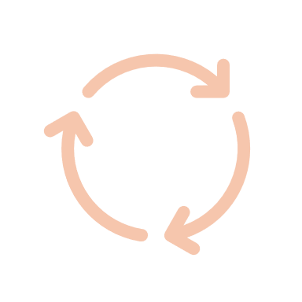

Agile Phases
1. A meeting is held with the client to obtain project requirements, budget, and timeline.
5. The team’s finished work for the sprint is reviewed by the Product Owner and, possibly, the client. Here, either party can give feedback on the latest state of the project.
2. The Product Owner develops the initial Product Backlog with input from the Scrum Master.
6. The Scrum Master guides their team through a sprint retrospective to reflect on what went well and what could be improved for the next sprint.
3. The Scrum Master helps their development team plan the sprint. This means planning which user stories will be completed by whom and what their successful completion will require.
The initial arrow represents the project’s beginning. The inner loop represents phases 3 – 6, in which sprints are repeated until the project’s conclusion, signaled by the exit arrow.
7. A new sprint begins, and the cycle is repeated until the project’s conclusion.
4. The sprint! This is the heart of the Agile process in which team members work on their user stories and meet daily for the “daily scrum” to discuss progress, planning, and obstacles. It can last from a week to a month.
8. The working product is complete, and it fulfills the client’s expectations. The project ends.

Slide 5

The Waterfall Model
This is the foil to Agile.
It follows a more linear path, beginning with gathering client requirements at the top and ending with a fully approved and completed product at the bottom.³
It does not use sprints—instead, the system is analyzed and designed before development begins.
After development is completed, the system is tested before receiving client approval. This marks the end of the project, although further maintenance may occur.³
The waterfall visual represents how, once one phase is complete, there is no turning back, as though each phase is water falling over a cliffside.

Slide 6
Waterfall or Agile?
There are pros and cons to each depending on the project.
Waterfall is plan-driven, so it requires thorough and precise planning to succeed.¹
Waterfall thrives for short projects in which the requirements are rigid and clearly defined. It fails when requirements change, as the model doesn’t support revisiting phases.
Because the product is not tested until late in development, waterfall runs the risk of delaying a project’s completion if extensive re-working is needed.
Agile is adaptive, so it seeks to plan as little as possible and, instead, adjust course with each sprint.¹
Agile works best for projects with uncertainty, like when the client isn’t sure of what they want. Through repeated iterations of a product, the team and client get closer toward their shared goal: a working product that fulfills the client’s vision.
This approach can fail if team members aren’t trained or committed for it. It requires group effort.

Slide 7
References
Cobb, C. G. (2015). The project manager’s guide to mastering Agile: Principles and practices for an adaptive approach. Wiley.
DevQA. (2017). Agile testing mindset and the role of the Agile tester. https://devqa.io/agile-testing-mindset-tester-role-agile-team/
Geeks for Geeks. (2024). Waterfall model – Software engineering. https://www.geeksforgeeks.org/waterfall-model/
Schwaber K. & Sutherland, J. (2020). The 2020 Scrum guide. Scrum Guides. https://scrumguides.org/scrum-guide.html#increment

